Slide 1
Welcome!
Everything is fine.

Slide 2

Image source: Strange Planet

Slide 3
UTSA CS 4593: CS-CURE
Course-based Undergraduate Research Experience in CS
Amanda Fernandez, Ph.D
UTSA Department of Computer Science
Spring 2024

Slide 4
UTSA CS-CURE
Course-based Undergraduate Research Experience
Instructor: Dr. Amanda Fernandez
Resources: Canvas
Class meetings: Tuesdays & Thursdays 11:30am - 12:45pm BB 3.03.24
Office hours: Tuesdays & Thursdays 10:15am - 11:30am NPB 3.326
Grader: TBA

Slide 5
Week 1: Motivation & Setup

Slide 6
UTSA CS-CURE
Week 1
Objectives:
Introduce the course, syllabus
Begin thinking like a research scientist
Identify your field(s) of research interest within CS
Deliverables:
Activity 1 (in class on Thursday)
Quiz 0

Slide 7
Research in Computer Science
WHY?
Develop
valuable skills
Discover your passion &
career path
Boost your resume &
open doors
Deepen understanding
Personal growth
Build connections

Slide 8

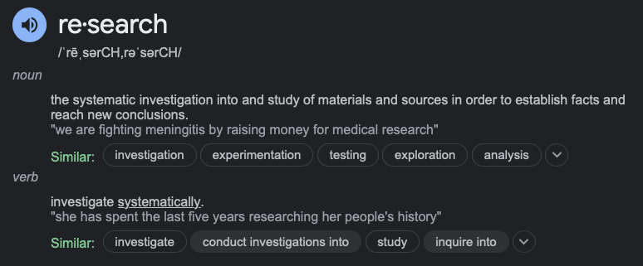
Research is not…
“Guess & check”
Learning an established topic/field/concept
Completed alone
Impossible to contribute to

Slide 9
Research
by the numbers
$200 billion
U.S. Government
annual spending on R&D for defense & civilian functions
(Approximation from the NSF FY2023)
$141 million
UTSA
annual research expenditures
(UTSA FY 2022 annual report)
“R&D” = research & development
“NSF” = National Science Foundation
“research expenditure” = money spent on research activities.
“direct” costs = salaries for researchers, benefits, travel, materials
“indirect” costs = administration costs, tuition/fees for student researchers

Slide 10
Image source: www.utsa.edu

Slide 11
Research in Computer Science
What does it look like?
It varies!
Some organizations use a “technology readiness level” (TRL) to describe the levels between forming an idea and deploying it commercially.
1-3 = “basic research”
4+ = “applied research”
Image source: Arnouts et al, DOI=https://doi.org/10.3389/fvets.2022.1016959

Slide 12
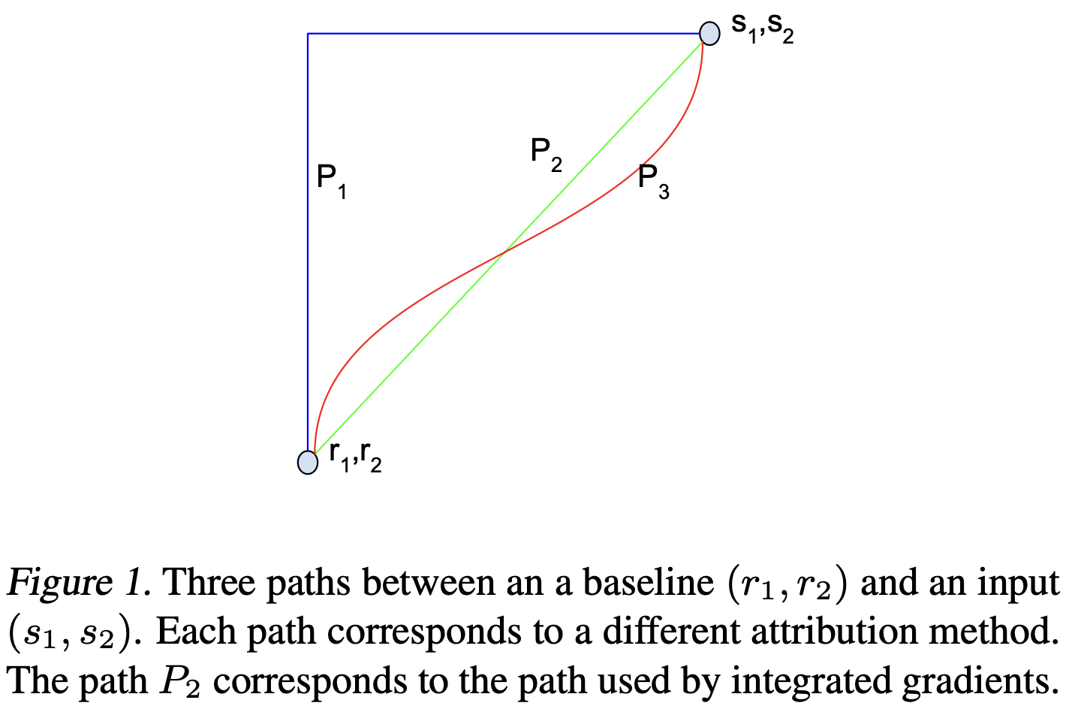
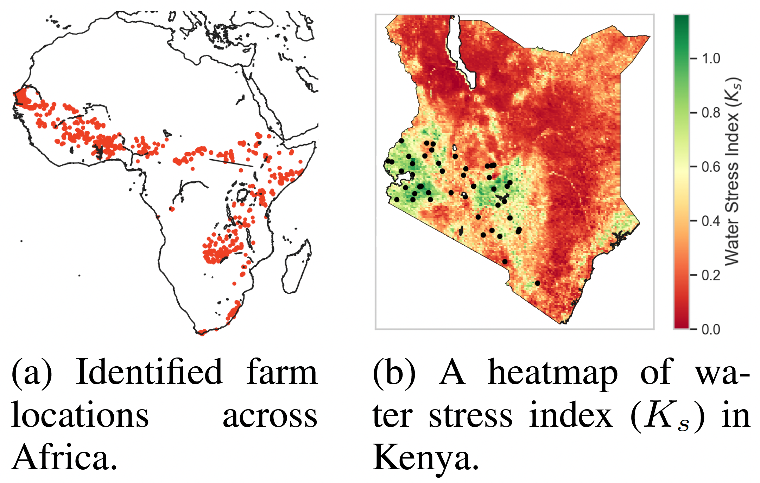
Research in Computer Science
What does it look like?
Example: Artificial Intelligence (A.I.)
Basic research = interpretability for deep learning
Axiomatic Attribution for Deep Networks. [Sundararajan et al, ICML 2017]
Applied research = AI for social good
Mitigating Low Agricultural Productivity of Smallholder Farms in Africa: Time-Series Forecasting for Environmental Stressors. [M. Tabar et al, AAAI 2022]

Slide 13
Research in Computer Science
What does it look like?
Example: Cybersecurity
Basic research = formal methods
Formal Methods for Network Performance Analysis. [Arashloo et al, USENIX NSDI 2023]
Applied research = bug bounty systems
Bug Hunters’ Perspectives on the Challenges and Benefits of the Bug Bounty Ecosystem. [Akgul et al, USENIX Security 2023]

Slide 14
Research in Computer Science
What does it look like?
Example: Computer Science Education (CSE)
Basic research = broadening participation
Socially Responsible Computing in an Introductory Course. [Gautam et al, ACM SIGCSE 2024]
Applied research = developing teaching strategies
Pairing Ungrading with Project-Based Learning in CS1 for Inherently Flexible Course Design [Smith, ACM SIGCSE 2024]

Slide 15
Research in Computer Science
How can I get involved?
Become a researcher
Undergraduate Research Assistant (URA)
Graduate Research Assistant (GRA)
Postdoctoral Researcher (postdoc)
Volunteer
Clinical trials
Citizen science
Volunteer for research studies
Support
Advocate & raise awareness
Donate to fund research or leverage your skills

Slide 16
Research in Computer Science
So many questions!
Do I need an advanced degree?
Should I do “basic” research or “applied”?
How should I pick a program/advisor/lab?
What jobs are there in CS research?
What does a day in the life of a researcher look like?
How do I find a topic that is interesting to me?
Is there active research/funding in my field of interest?
How do I find people with similar interests?
How do I get caught up with my field?
What’s an IRB, and do I need it?
…..
Our goal is to answer your questions through this course.
What do YOU want to know?

Slide 17
What is a CURE?

Slide 18
What is a CURE?
Course-based Undergraduate Research Experience
= courses offered by specific (often science or engineering) departments with the following elements:
There is an element of discovery, so that students are working with novel data.
Iteration is built into a lab or engagement activity.
Students engage in a high level of collaboration.
Students learn scientific practices.
The topic of research is broadly relevant so that it could potentially be published and/or of interest to a group outside the class.
(Auchincloss et al. 2014)

Slide 19
What is a CURE?
Course-based Undergraduate Research Experience
In general, research engagement must have the following attributes:
Attribute 1: Research design should be based on the established philosophical stances that are scientifically valid relative to the field of study. Where borrowing or learning from another field of study, a clear justification must be provided.
Attribute 2: The design should employ research techniques and methodological approaches that have proven dependable and reliable and that are directly relevant to the nature of the research problem.
Attribute 3: Research design should be structured to avoid unscientific hypothesis formulation, subjectivism and bias.
Attribute 4: The analytical discussion should avoid speculation and present well-reasoned analytical arguments.
Attribute 5: The research should be monitored and take place in a controlled environment (quantitative research) or within a relatively limited scope (quantitative and qualitative research).
Attribute 6: The research should adopt rigorous and structured procedures.
Attribute 7: Research should be logical and systematic.
Attribute 8: The final research output and the research manuscript should have a valid, verifiable conclusion.
Attribute 9: In some cases, the research manuscript should present an empirical conclusion.
Jannach et al. (2012)

Slide 20
What is CS-CURE?
Course-based Undergraduate Research Experience in CS @ UTSA
It is not an independent study.
It is a structured course on research methods, with a focus on research for new/beginning computer scientists. Consists of:
Lectures - new materials & tools needed to understand research in CS
Activities - designed to reinforce the new concepts & enable hands-on experience
SIG meetings - engaging with peers who have similar interests
Guest lectures - focused research talks on a variety of CS topics

Slide 21
Motivation for
CS-CURE at UTSA
Most common UTSA CS undergraduate experience
Proposed research-focused experience
CS 1,2,3
1900+ undergraduate CS majors
CS-CURE is designed to provide a scalable solution to undergraduate research engagement in our department.
Study your topic of interest (in CS)
Engage with peers with similar interests
Build skills necessary to impact your field
CS Core
CS-CURE
Plus 119 masters students, 71 PhD students. Faculty: 26 T/TT and 18 FTT. [Fall 23]
Internship
Advanced Topics
Ind. Study
Industry Job
Grad School

Slide 22
CS-CURE at UTSA
Most common UTSA CS undergraduate experience
Proposed research-focused experience
CS 1,2,3
Important notes:
CS1 is the only prerequisite
(There will be a range of student expertise in the class)
The course is generalized to all CS
(The course will focus on research “how to”, and you will focus on applying it to your field)
CS Core
CS-CURE
Internship
Advanced Topics
Ind. Study
Industry Job
Grad School

Slide 23
What is CS-CURE?
TL:DR
Tuesdays = general content on research in computer science
Thursdays = in-class activities applying the concepts to your research topic

Slide 24
Syllabus

Slide 25
Special Interest Groups (SIGs)

Slide 26
Special Interest Groups (SIGs)
Peers in the field
Critical to each step in the research process..
Identifying relevant topics
Evaluation metrics for experiments
Data analysis techniques
Reporting conclusions
Image source: Wikipedia

Slide 27
Special Interest Groups (SIGs)
Communities or subgroups within a larger organization or association that share a common, specific interest, focus, or goal.
Formed to bring together like-minded individuals who have a passion for a particular area within a broader field or discipline.
Provide a platform for members to collaborate, exchange ideas, and work on projects related to their shared interest.
Can be found in various domains, including academia, professional organizations, and hobbyist groups.

Slide 28
Special Interest Groups (SIGs)
Key characteristics
Focused Interest: SIGs have a well-defined and specific interest, often within a larger field. This focus allows members to engage deeply in discussions and activities related to their shared interest.
Membership: SIGs attract individuals who share a common passion or professional interest. Members may come from diverse backgrounds but are united by their focus on a particular niche.
Activities: SIGs often engage in various activities, such as organizing events, conferences, webinars, workshops, or publishing newsletters and journals related to their field of interest.
Collaboration: Members collaborate on projects, research, or initiatives related to their interest. They may also share resources, knowledge, and experiences.
Autonomy: SIGs often have a degree of autonomy within the larger organization or association. They may have their own leadership, governance, and decision-making processes.
Networking: SIGs offer members opportunities to network with others who share similar interests, which can lead to collaborations and career opportunities.

Slide 29
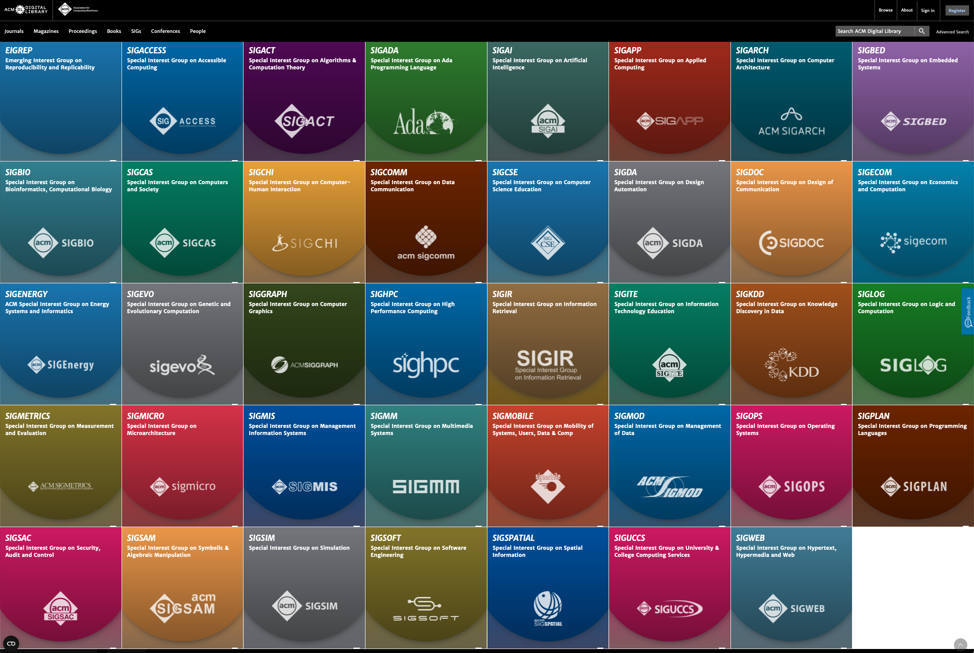
TL;DR:
There are lots!

Slide 30
Wrap-Up
Tuesday
Motivations for research
CS-CURE course setup
To Do:
What topic area within CS seems most interesting to you?
Complete Quiz 0 on Canvas
See you Thursday!
Mostly survey questions!

Slide 31
Activity 1: Research Basics

Slide 32
Activity 1: Research Basics
Thursday
Introduction
Finding your field of interest and previewing topics
In-class activity (turn in by end of class)
Wrap-up discussion

Slide 33
Activity 1: Research Basics
Introduction
Research can be overwhelming if too broad…let’s take small steps:
Narrow down your field within CS
Review interesting topics in the field
Investigate open questions in the field
Come up with a hypothesis or question of your own
This week
Next week
Later in the semester
This is when you’ll start to see smaller groups of the same researchers!

Slide 34
Activity 1: Research Basics
Finding Your Research Interest
Handout 1: CS interests question flowchart
Activity: reflect on your likes & dislikes within CS
Goal: identify a field (or combination of fields) you enjoy the most
Handout 2: Research topic “bingo”
Activity: preview some research topics across a range of CS fields
Goal: look for trends among the topics you might be interested in (and among those you are not)

Slide 35
Activity 1: Finding Your CS Research Field
Do you prefer….
Building things
Problem solving
Low-level or High-level?
Enjoy Math?
Yes!
Low
High
Not really
Maybe?
Check out:
Algorithms
Computational Complexity
Optimization
How low?
Spending all of your time on the code would be…
Any interests outside of CS?
Interested in AI?
On the hardware
Making the hardware
Very!
Maybe/not?
Ok
Torture
Lots!
Not really
Enjoy explaining technical concepts?
Look into:
Embedded systems
IoT / Networking
High performance computing
Check out:
Quantum computing
Neuromorphic computing
Hardware design
Would you rather…
Consider:
AI applications in other fields - architecture & engineering, physical sciences & health, education, the arts..
Think about:
Data science
Data analysis
Data mining
Using it or building it?
Yes!
Not always
Check out:
CS Education
Consider:
Formal methods
Software verification
Using it
Building it
Break it
Build something for commercial use
Consider:
AI applications in other fields - architecture & engineering, physical sciences & health, education, the arts..
AI Ethics
Look into:
Computer vision
Natural Language Processing (like ChatGPT)
Learning model optimization
Consider:
Cybersecurity
Software verification
Check out:
Database systems
Cloud computing
Human-Computer Interaction (and systems like AR/VR)
Instructions:
Beginning at the top, answer the questions (honestly!) to discover which Computer Science research fields might be of interest. Circle the blue boxes that correspond with a good match to your answers, and cross out any that are not of interest. Leave the rest unmarked.

Slide 36
Activity 1: Finding Your CS Research Field
Building a Secure and Scalable Decentralized Cloud Storage System | Designing secure communication protocols that resist vulnerabilities like eavesdropping, data manipulation, and denial-of-service attacks. | Towards Secure and Reliable Quantum Computing Hardware | Constructing consistent digital line segments
Investigating resource sharing and trading mechanisms between edge nodes to optimize utilization | Designing feedback mechanisms that provide meaningful and actionable insights to support student learning and program improvement. | Efficiently segmenting images with texture | The Computational Complexity of Quantum Annealing
Developing efficient algorithms and hardware architecture for performing machine learning tasks directly on embedded devices. | Establishing fairness metrics for AI models | Developing efficient data partitioning and aggregation techniques for distributed ML architectures | Leveraging explainable AI for anomaly detection large datasets
Leveraging Explainable AI for Real-Time Medical Diagnosis | Building privacy-preserving data mining solutions for bioinformatics | Developing new techniques for visualizing and interacting with real-time data streams in AR/VR environments | Designing distributed and parallel data mining algorithms for processing large datasets on cloud platforms
Instructions:
Review each research topic. Circle any topics you might want to read more about right now, and cross out any that are not of interest. Leave the rest unmarked.

Slide 37
Systems
Theory
Building a Secure and Scalable Decentralized Cloud Storage System | Designing secure communication protocols that resist vulnerabilities like eavesdropping, data manipulation, and denial-of-service attacks. | Towards Secure and Reliable Quantum Computing Hardware | Constructing consistent digital line segments
Investigating resource sharing and trading mechanisms between edge nodes to optimize utilization | Designing feedback mechanisms that provide meaningful and actionable insights to support student learning and program improvement. | Efficiently segmenting images with texture | The Computational Complexity of Quantum Annealing
Developing efficient algorithms and hardware architecture for performing machine learning tasks directly on embedded devices. | Establishing fairness metrics for AI models | Developing efficient data partitioning and aggregation techniques for distributed ML architectures | Leveraging explainable AI for anomaly detection large datasets
Leveraging Explainable AI for Real-Time Medical Diagnosis | Building privacy-preserving data mining solutions for bioinformatics | Developing new techniques for visualizing and interacting with real-time data streams in AR/VR environments | Designing distributed and parallel data mining algorithms for processing large datasets on cloud platforms
Applications
Data
Instructions:
Review each research topic. Circle any topics you might want to read more about right now, and cross out any that are not of interest. Leave the rest unmarked.

Slide 38
Activity 1: Research Basics
Special Interest Groups (SIGs)
Part 1: Forming [initial] SIGs
Activity: physically relocate within the class to be near folks in your field
Goal: test drive a SIG for the day
Part 2: Discussions & Activity 1 Worksheet
Activity: complete the Activity 1 worksheet (to be turned in at the end of class)
Goal: initiate discussions among peers with similar interests, consider topics of interest

Slide 39
Activity 1: Research Basics
Special Interest Groups (SIGs) - Activity part 1
I will help balance the groups if/where needed.
Let’s try to form groups according to field of interest:
AI
Computing Foundations
CS Education
Cybersecurity
HCI
Software Engineering
Systems
Other
“I have no idea”
This is not a commitment to the topic for the semester (yet!)

Slide 40
Activity 1: Research Basics
Exploring Potential Topics - Activity part 2
Reflect on the 2 handouts and your experiences with them
Discuss your experience in the field related to your SIG
Complete the activity handout (requires some discussion with your new research community!)

Slide 41
Wrap-Up
Thursday
Exploring research topics of interest to you
Investigating recent research
Discussion within a research community
To Do:
Complete Quiz 0 on Canvas
See you next week!
Mostly survey questions!

